Slide 1

Python Packet Reconstruction
Abhinav Jambulingam
Adam Catalfano

Slide 2
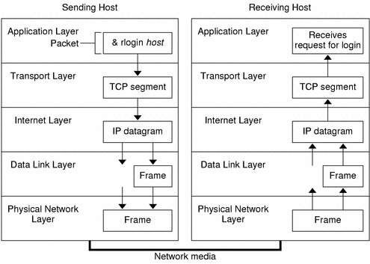
TCP packets
Transmission Control Protocol (TCP)
Internet standard used to exchange of packets
Guarantees that bytes are transmitted in the order they sent

Slide 3



Packet Sniffing
Technique used to detect and observe packets flowing in the network
-Examines the data stream of packets
Wire Shark, SmartSniff

Slide 4
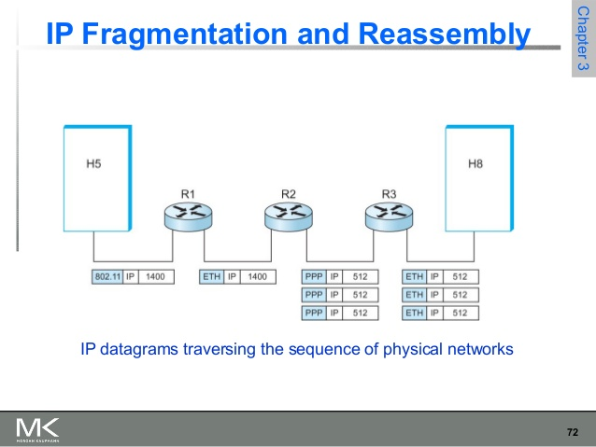
Packet Reassembled
Process to assemble packets that were fragmented.
Involves reading packets on a stream and reassemble based on various aspects of:
Ip headers
Ip data
Byte sequence

Slide 5

Implementation
Python Traffic sniffing tool:
- that will read incoming and outgoing packet streams
Reconstruct the packet fragments to form a new data
Converts 6 character string of ethernet add to colon separated hex string
Use the IP headers to match the incoming packets and reassemble

Slide 6
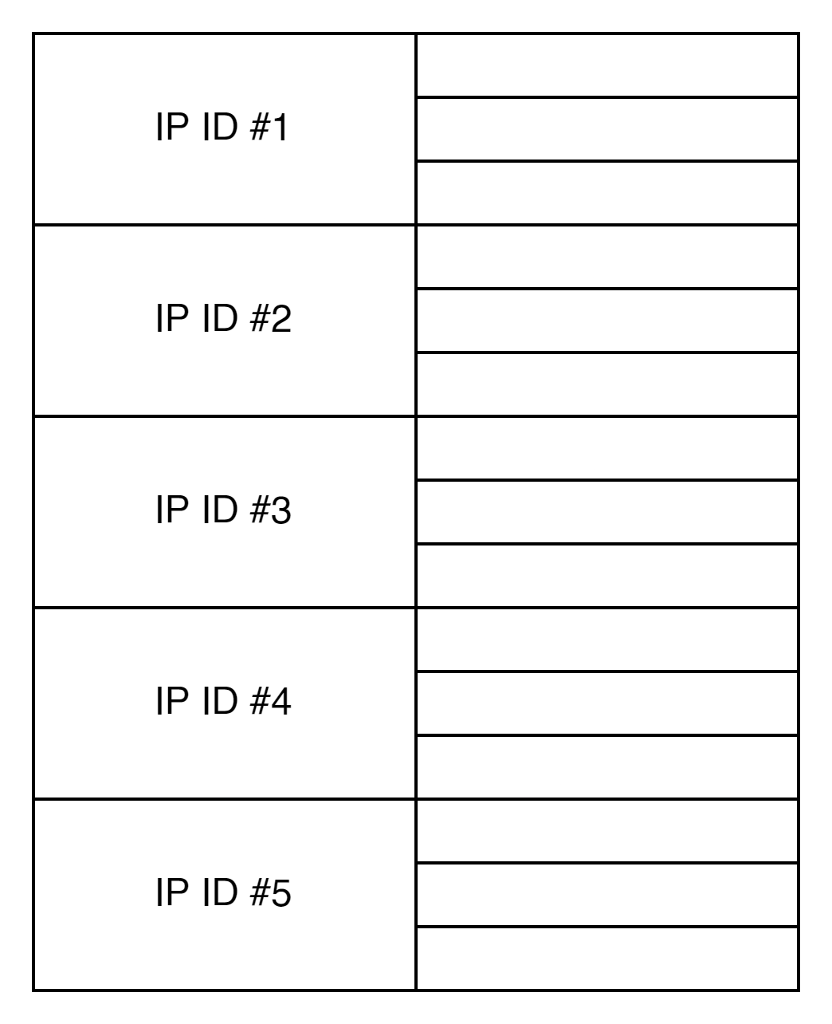
IP FRAGMENT RECONSTRUCTION
Map IP ID’s
To Fragment Mapping
1 Frag Map per IP ID

Slide 7
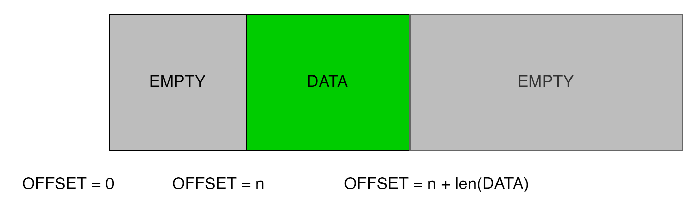
IP FRAGMENT RECONSTRUCTION
Add first fragment
Populate with mappings to empties
Offset from header and data length

Slide 8
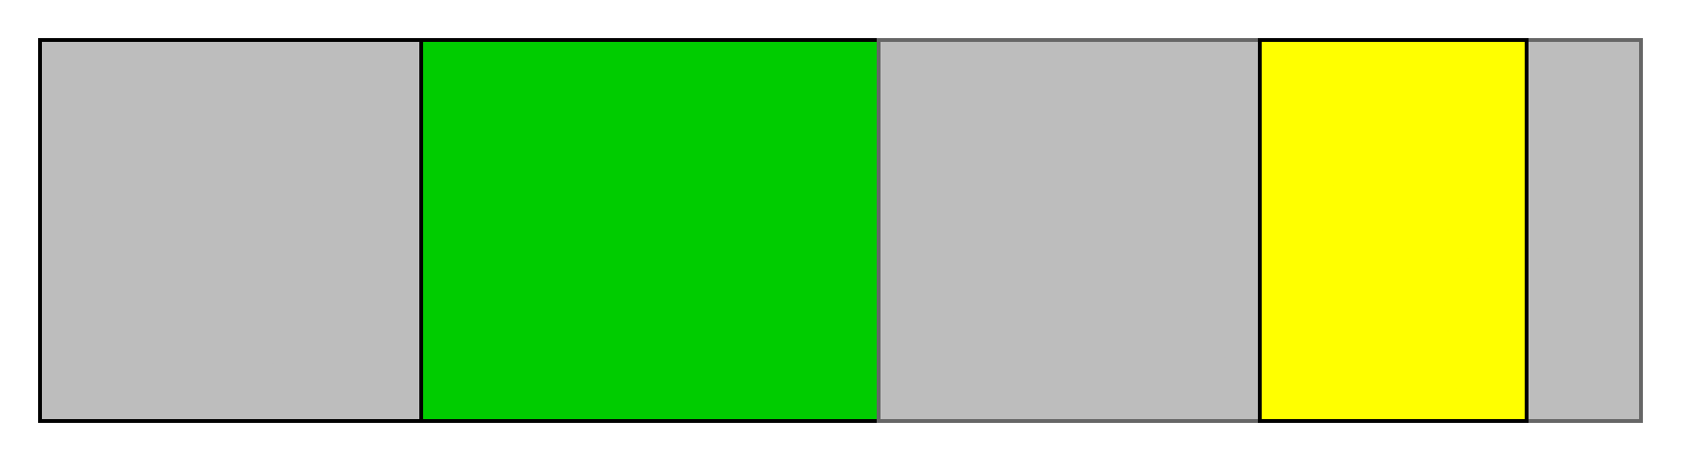
IP FRAGMENT RECONSTRUCTION
Continue
Add gaps where appropriate

Slide 9
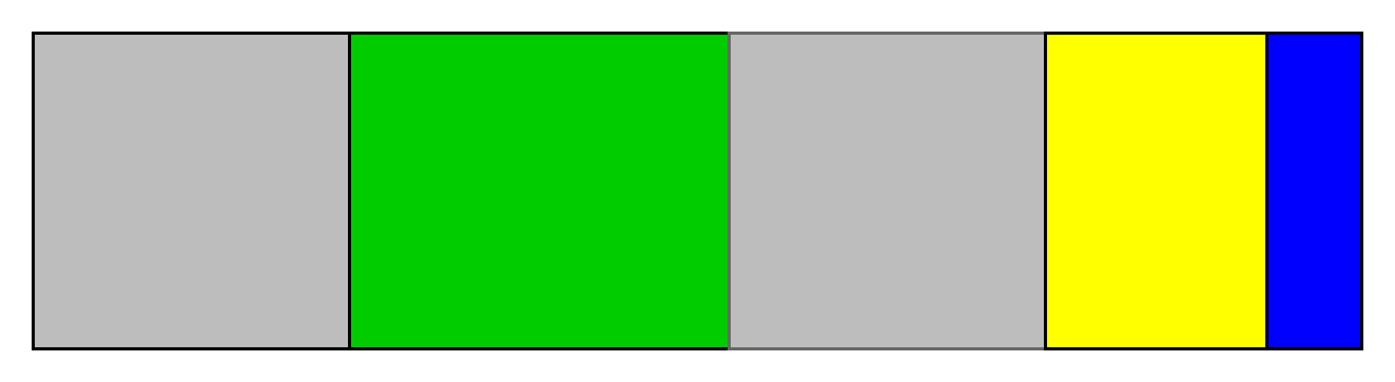
IP FRAGMENT RECONSTRUCTION
Continue
Add gaps where appropriate
Know at end b/c of MF flag (“more fragments”)

Slide 10
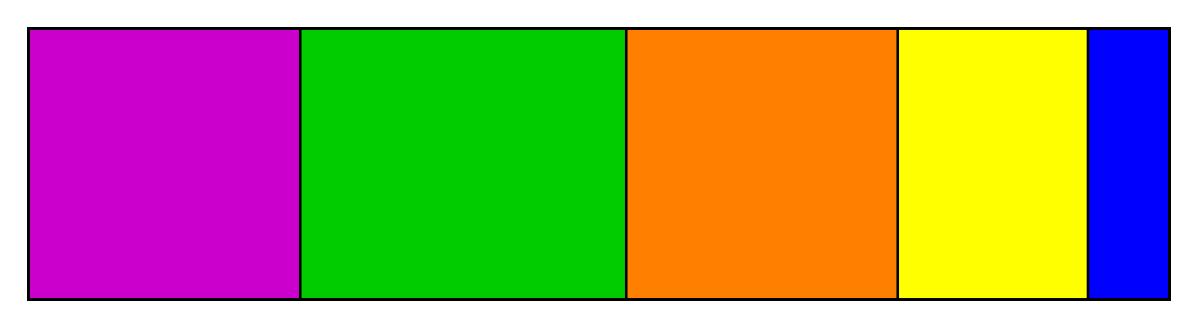
IP FRAGMENT RECONSTRUCTION
Until eventually filled
We have a fully reconstructed IP Packet!

Slide 11
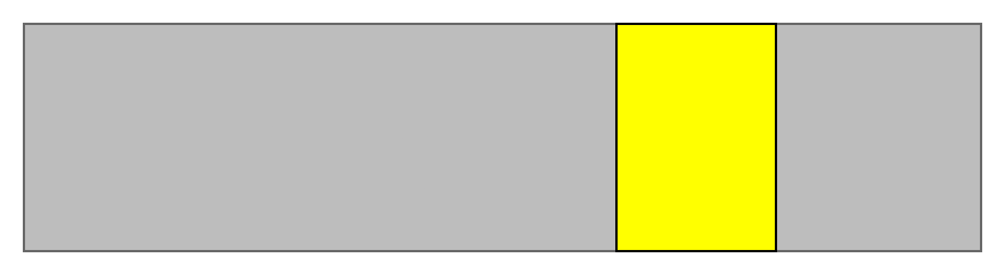
TCP Reordering
Same as IP reconstruction
...Almost

Slide 12
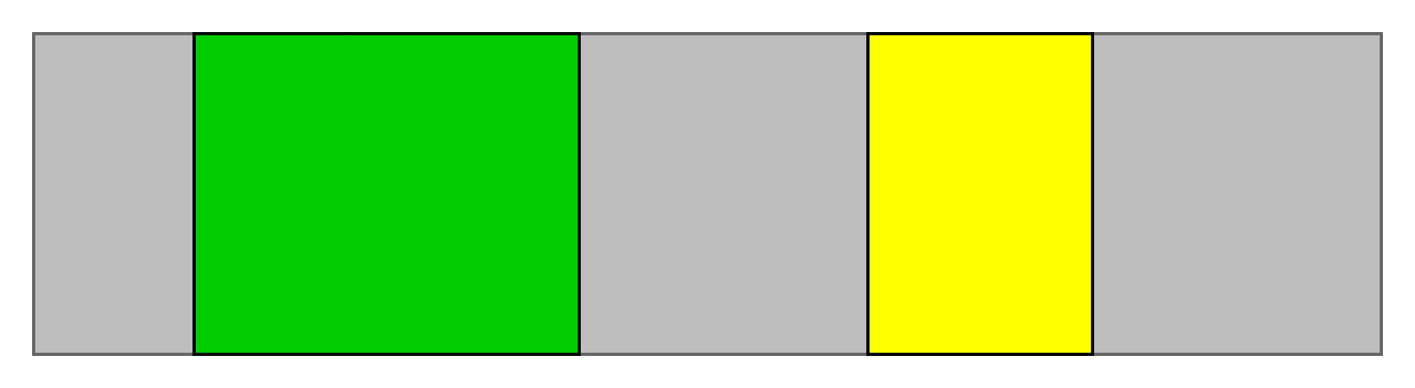
TCP Reordering
Unless we get a 0-offset, never flush with left
And never get a 0-offset b/c 3-way handshake already offsets
(Data must start at offset greater than min -- 0)

Slide 13
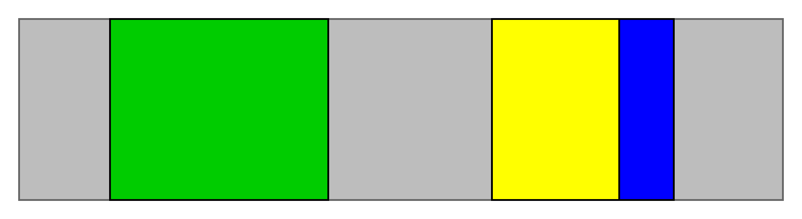
TCP Reordering
Never flush with right
TCP is a “byte-stream service”
Does not include “end of stream” semantics

Slide 14
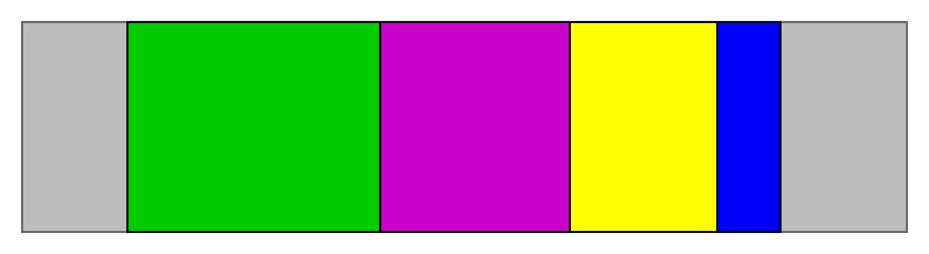
TCP Reordering
So when all but lhs and rhs gaps are full...

Slide 15

TCP Reordering
Trim gaps to display stream
Keep around just in case more within those gaps incoming

Slide 16


